Slide 1
Business Plans
Mgt 5814
Entrepreneurial Leadership
Week 4

Slide 2
Week 3: Review
The Client??? Where are we?
The Audacity of Zero
  Think Big, start small
  The Value Hypothesis
  The Growth Hypothesis
  The Concierge Min Viable Product
Four Key Questions:
  Do consumers recognize that they have the problem you are trying to solve?
  If there was a solution, would they buy it?
  Would they buy it from us?
  Can we build a solution for that problem?

Slide 3
Street Testing Your Plan A
Business model element | Relevant analogs and the numbers they give you | Relevant antilogs | Leaps of faith around which you will build your current dashboard | Hypotheses that will prove or refute your leaps of faith
Revenue model
Gross margin model
Operating model
Working capital model
Investment model
Review

Slide 4
Our Plan A
Problem Opportunity | Degrees based upon classes, exam and/or experience | Errands—Rush hour grocery delivery | Car maintenance to you | Simulator for driving schools (DMVs)
Analog | -Transfer credits -SAT/GMAT -Law—bar -Accounting—CPA | -Amazon -P-Pod -Fed Ex/UPS -UBER | -Safe-lite Repair -AAA (tire/battery) | -Airplane simulator -Video games (GTA, Nascar)
Antilog | -Focus on exam -Offers of knowledge (ranks) | -Multiple versions -Go around to locals | -More services ---preventative ---inspections ---Not emergency | -Education -Testing -Use of feedback
Leaps of Faith | -Will busns recognize it? -Will it kill colleges? How to avoid cheating? | -COGS (payment) -Can we organize the pickups & deliveries? | -Demand? -Portable equip? -Overhead/fee? -Neighborhoods? -Will corps pay? | -Would DMV accept? -Accuracy of simulation? -Costs/payments? -Defensive?
Review

Slide 5
Our Plan A
Problem Opportunity | Video Game Club (bowling) | Sharing of apartment parking | Local sports clubs (teams w/ coaches) | Elderly Support
Analog | -Bowling alleys -old pinball arcades -theaters w/ restaurants, | -Uber -Illegal DC parking sharing | -Dating services | -Dating services -Home nurses -Meals on wheels
Antilog |  |  |  | *Retirement home—shorter interactions
Leaps of Faith |  |  |  | -Is there insurance or regulations? -Are there specific services (driving, friendship)?
Review

Slide 6
Testing a Leap of Faith
Leap of Faith question | Revised hypothesis | Metrics | Finding | Insight or response
Review

Slide 7
Beyond the “right place”
Many others were there at the same time, some ahead of the eventual entrepreneurial “winner”.
Value & Growth
  Why might your idea grow?
  Genchi Gembutsu (go and see for yourself), Get out of the building
  Design and the Customer Archetype
  Analysis Paralysis

Slide 8
Test
Minimum Viable Product
  What are the minimal features that allow for tests of the leaps of faith?
  Requires judgment
The Concierge MVP
  Intensify the interactions between the customer and the organization for the organization to better understand the customers
Wizard of Oz prototype
  Substitute inefficient but cheap processes to replicate the yet-to-be-developed processes which will appear in the final product

Slide 9
Quality & Design
If we don’t know who the customer is, we do not know what quality is.

Slide 10
Measure
A startup’s job is to
  Rigorously measure where it is right now, confronting the hard truths that assessment reveals
  Devise experiments to learn how to move the real numbers closer to the ideal reflected in the business plan
  Avoid the zone of the living dead

Slide 11
Leaps of Faith into a financial model
Every business plan has a model with assumptions built into it.
  The profitability of each customer
  The costs of acquiring new customers
  The repeat purchase rate of existing customers

Slide 12
Innovation Accounting
Use a MVP to establish real data on where the company is right now.
Tune the engine from the baseline to the ideal.
Pivot or preserve.

Slide 13
Establish the baseline
How do you test if customers recognize they have the problem?
  Preorders (smoke test) Learning milestones
  Test the riskiest assumptions first

Slide 14
Tuning the engine
Target all actions at improving one of the drivers of growth
Learning, not optimization of the current efforts
  Avoid “vanity metrics”
  Actionable metrics, not vanity metrics
  Agile development: series of sprints, gather usage data, changes
  Cohorts and split-tests
  Kanban diagram (backlog, in progress, built, validated): no bucket can contain more than three projects at a time.

Slide 15
Metrics
Actionable
  Demonstrate clear cause and effect.
Accessible
  Be understood by the employees and managers that use them in decision making processes.
Auditable
  Credible to the users.

Slide 16
Developing the Business Plan
Business planning has not been found to predict venture success
  Some investors still require it
  The process allows for debate on critical questions and assumptions
  These assumptions and milestones are the foundation for identifying resources, cash flow forecasts which indicate financing needs.

Slide 17
The Plan vs The Pitch
A business plan is a document which articulates the proposed venture’s business model and provides significant additional detail.
  Four types of plans: Traditional plan; Mini-plan; Go-to-market plan; and an operating plan
A business pitch is a presentation that can be used to communicate the business model to investors, customers, partners, advisers, potential employees, and other stakeholders.

Slide 18
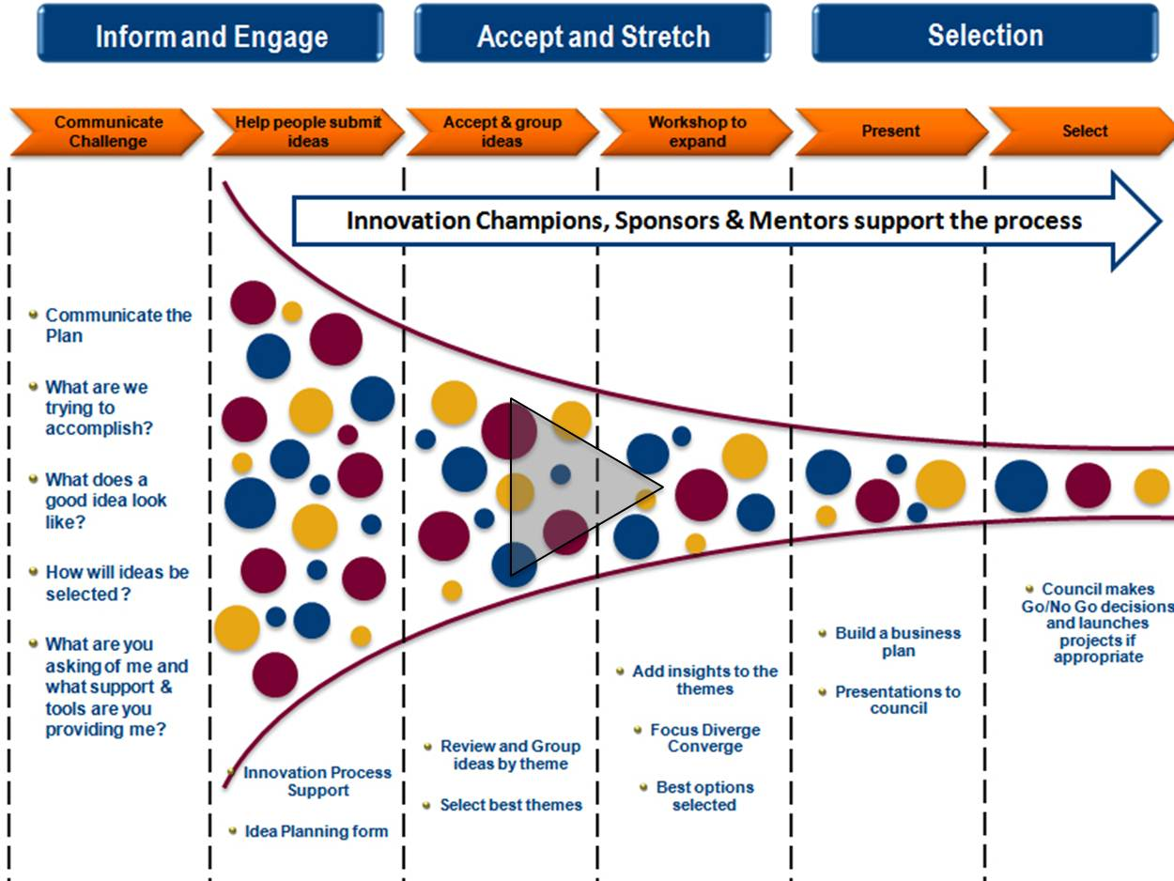

Slide 19
A business plan provides
An opportunity to test ideas and determine whether viable business opportunities exist.
The foundation for debating and analyzing key assumptions, developing financial forecasts, and designing early experiments.
A baseline that clarifies aspirational milestones as the entrepreneur experiments to build a minimal viable product or service offering that will engage the market.
A clear statement of the metrics that will be used to test assumptions and measure performance as the team works to achieve key milestones.
An approach to communicating with others about the business while raising money; assembling a team; and attracting suppliers, customers, and partners.

Slide 20
Financial info in a plan/pitch
Cash flow
  Sources of revenue, costs, and expected losses
Forecasts for burning cash, turn cash flow positive, and begin generating profits
Typically 3-5 years (may vary)

Slide 21
Protecting IP
NDAs & Confidentiality agreements
Patents

Slide 22
Types of business plans
Mini-business plans
  Summary of the essential components of the venture’s strategy, its go-to-market and operating plans, and how these plans translate into financial forecasts.
  Appendices: biographies for team members, market data, and key industry players.

Slide 23
Types of business plans
Traditional business plans
  More detailed discussion of the strategy and go-to-market and operating plans, and provide significant detail on how these translate into financial forecasts, including multiple scenario-based stress tests to clarify key areas of uncertainty and risk.
  Once common, now these types of plans are being replaced by other forms.

Slide 24
Types of business plans
Go-to-market plans
  Describe the unmet needs of early adopter customers; the product, service, or solution that will be developed to address these needs; and the value proposition and benefits that will be delivered.
  Entry product/service, alternatives in the market; how to inform the customer regarding the new product and its pricing, and how to attract mainstream customers (crossing the chasm)

Slide 25
Types of business plans
Operating plans
  Define the key activities and milestones that must be accomplished.
  Used to identify resources (talent, technology, infrastructure, equipment, facilities) that will be needed to launch the new venture.

Slide 26
Pitching the plan
Business plan pitch
  Presentation that can be used for investors and other stakeholders.
Elevator pitch
  One-paragraph description of the new business or opportunity that captures the idea for someone that is unfamiliar with the idea.

Slide 27
Common problems with pitch
Too many facts, not enough compelling information for decision making.
  Identify the objectives for the meeting, and craft the information to match.
  Why? Who? Where? What? When? How?
  The market’s pain.

Slide 28
The 11-slide Investor Pitch
Can be delivered in 20 minutes
Slides should focus on images, graphics, and charts that convey information clearly and visually.
  Talking points in the notes.
  Tell a story.

Slide 29
The 11-slide Investor Pitch
Title Slide: bios of the team
Slide 1: Executive Summary
Slide 2: Market Positioning or problem description
Slide 3: Product Positioning
Slide 4: Business Network (ecosystem) Positioning
Slide 5: Competition or substitutes
Slide 6: Customer Benefits
Slide 7: Operations
Slide 8: Financials
Slide 9: Risks
Slide 10: Implementation, Status and Traction, and Financing
Slide 11: Closing Slide (The Ask)
Optional supplementary slides or handouts
Hold-out slides: Anticipated responses

Slide 30
Business Pitch Elements
The Problem
The Solution
The Target Market (segmented)
The Competition
The Team
Financial Summary
Key Milestones

Slide 31
Hyconn
HyConn inventor Jeff Stroope on Shark Tank
Scared Straight Stickers
Best of Shark Tank Presentations
http://www.businessinsider.com/the-best-startup-pitches-of-all-time-2012-11?op=1
Harry and Paul Dragon's Den (the crown)
Harry and Paul Dragon's Den (Kitten Stomper)

Slide 32
Social Entrepreneurship
The challenge when sources and uses of cash come from different activities
  https://www.youtube.com/watch?v=QMs_Z80JYls Play Pump
  http://blogs.ei.columbia.edu/2010/07/01/the-playpump-what-went-wrong/
  http://www.pbs.org/frontlineworld/stories/southernafrica904/video_index.html
  https://www.youtube.com/watch?v=uQu_Jppvzyk#t=23.618091432

Slide 33
HourlyNerd
How we became

